Slide 1
RESOLUTION PROOF METHOD
Individual homework – Cîrstea Andrei Daniel

Slide 2
THEORY ASPECTS

Slide 3
Resolution Proof Method
It was proposed by J.A. Robinson in 1965 as a proof method for classical logics
Dedicated theorem provers based on resolution: OTTER, PCPROOVE, AMPHION, Jape
It was easily adapted to nonstandard logics (modal, temporal, many-valued, non-monotonic).
Its basic aim is to check the consistency/inconsistency of a set of clauses.
It is based on syntactic considerations => syntactic method
The validity of a formula is proved by contradiction=> refutation method

Slide 4
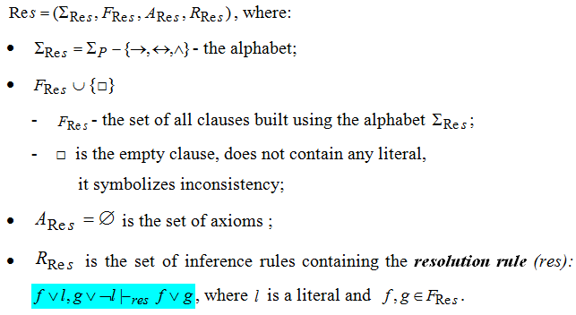
Resolution method - formal system for propositional logic

Slide 5
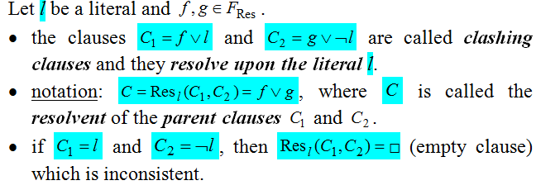
Definitions

Slide 6
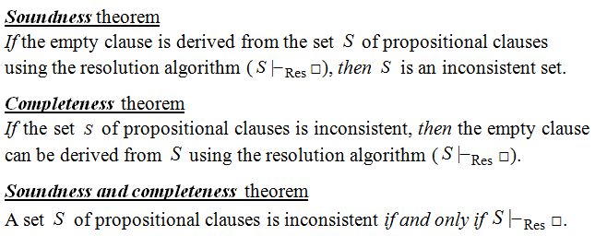
Theoretical result

Slide 7
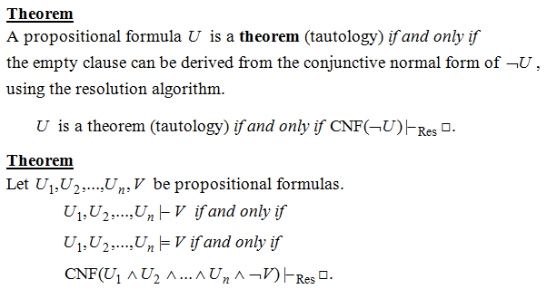
Resolution - a refutation proof method

Slide 8
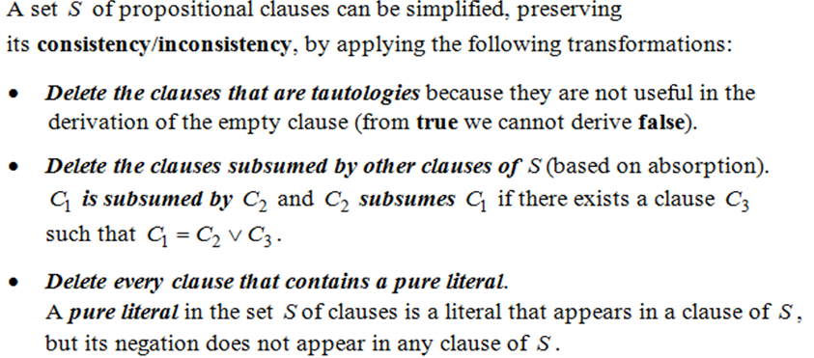
Theorem (based on Davis-Putman procedure)

Slide 9
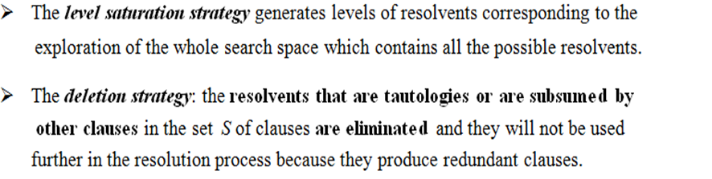
Strategies of Resolution

Slide 10
Solution

Slide 11
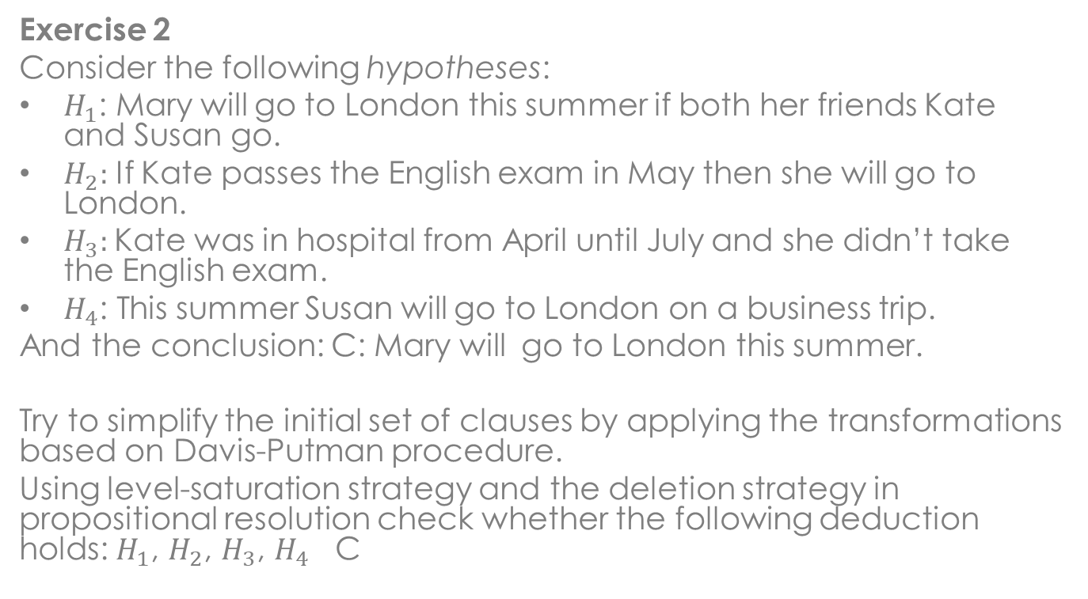
Problem statement
Exercise 2
Consider the following hypotheses:
$H_{1}$: Mary will go to London this summer if both her friends Kate and Susan go.
$H_{2}:$ If Kate passes the English exam in May then she will go to London.
$H_{3}:$Kate was in hospital from April until July and she didn’t take the English exam.
$H_{4}$: This summer Susan will go to London on a business trip.
And the conclusion: C: Mary will go to London this summer.
Try to simplify the initial set of clauses by applying the transformations based on Davis-Putman procedure.
Using level-saturation strategy and the deletion strategy in propositional resolution check whether the following deduction holds: $H_{1}$, $H_{2}$, $H_{3}$, $H_{4}$ C

Slide 12
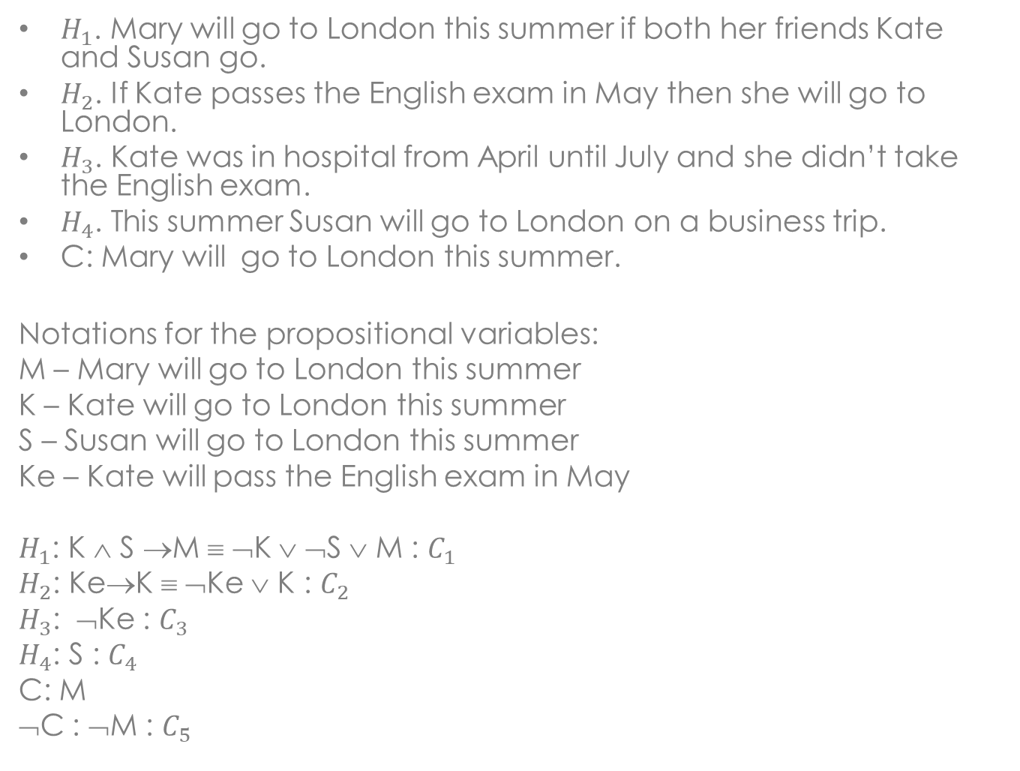
$H_{1}$. Mary will go to London this summer if both her friends Kate and Susan go.
$H_{2}$. If Kate passes the English exam in May then she will go to London.
$H_{3}$. Kate was in hospital from April until July and she didn’t take the English exam.
$H_{4}$. This summer Susan will go to London on a business trip.
C: Mary will go to London this summer.
Notations for the propositional variables:
M – Mary will go to London this summer
K – Kate will go to London this summer
S – Susan will go to London this summer
Ke – Kate will pass the English exam in May
$H_{1}$: K ∧ S →M ≡ ¬K ∨ ¬S ∨ M : $C_{1}$
$H_{2}$: Ke→K ≡ ¬Ke ∨ K : $C_{2}$
$H_{3}$: ¬Ke : $C_{3}$
$H_{4}$: S : $C_{4}$
C: M
¬C : ¬M : $C_{5}$

Slide 13

Davis-Putman procedure
X = {$C_{1}$. $C_{2}$, $C_{3}$, $C_{4}$, $C_{5}$}
$C_{1}$= ¬K ∨ ¬S ∨ M
$C_{2}$ = ¬Ke ∨ K
$C_{3}$= ¬Ke
$C_{4}$= S
$C_{5}$ = ¬M
There is a pure literal: Ke → $C_{2}$ and $C_{3}$ can be removed .
$C_{2}$= $C_{3}$ ∨ K → $C_{3}$ subsumes $C_{2}$ .
There are no tautologies.
The final set of clauses is S = {$C_{1}$, $C_{4}$, $C_{5}$}.

Slide 14

Level saturation and deletion strategy
Initial level: $S^{0}$ = S = { $C_{1}$= ¬K ∨ ¬S ∨ M, $C_{4}$= S, $C_{5}$ = ¬M }
First level:
$C_{6}$= ${Res}_{S}$($C_{1}$, $C_{4}$) = ¬K ∨ M
$C_{7}$= ${Res}_{M}$($C_{1}$, $C_{5}$) = ¬K ∨ ¬S
No tautologies → $S^{1}$= {$C_{6}$, $C_{7}$}
Second level:
$C_{8}$= ${Res}_{M}$($C_{6}$, $C_{5}$) = ¬K
$C_{9}$= ${Res}_{S}$($C_{7}$, $C_{4}$) = ¬K = $C_{8}$
No tautologies → $S^{2}$= {$C_{8}$}
Third level:
$S^{3}$ is empty → The conclusion cannot be deduced from the set of hypotheses.

Slide 15
Conclusion
The conclusion cannot be deduced from the given
set of hypotheses.

